Slide 1

Tour Guide Providing Service
Presented By:
Tanmoy Mazumder(19101013)
Ali Mostakim Alvi(19101015)
Shawan Das(19101020)
Presented TO:
Shammi Akhtar
Assistant Professor
CSE, UAP

Slide 2
Contents
Model
Definition of DFD and ER
Data Flow Diagram
Entity Relationship Diagram

Slide 3
Models
Logical Model
Physical Model
DFD Model
ER Diagram

Slide 4

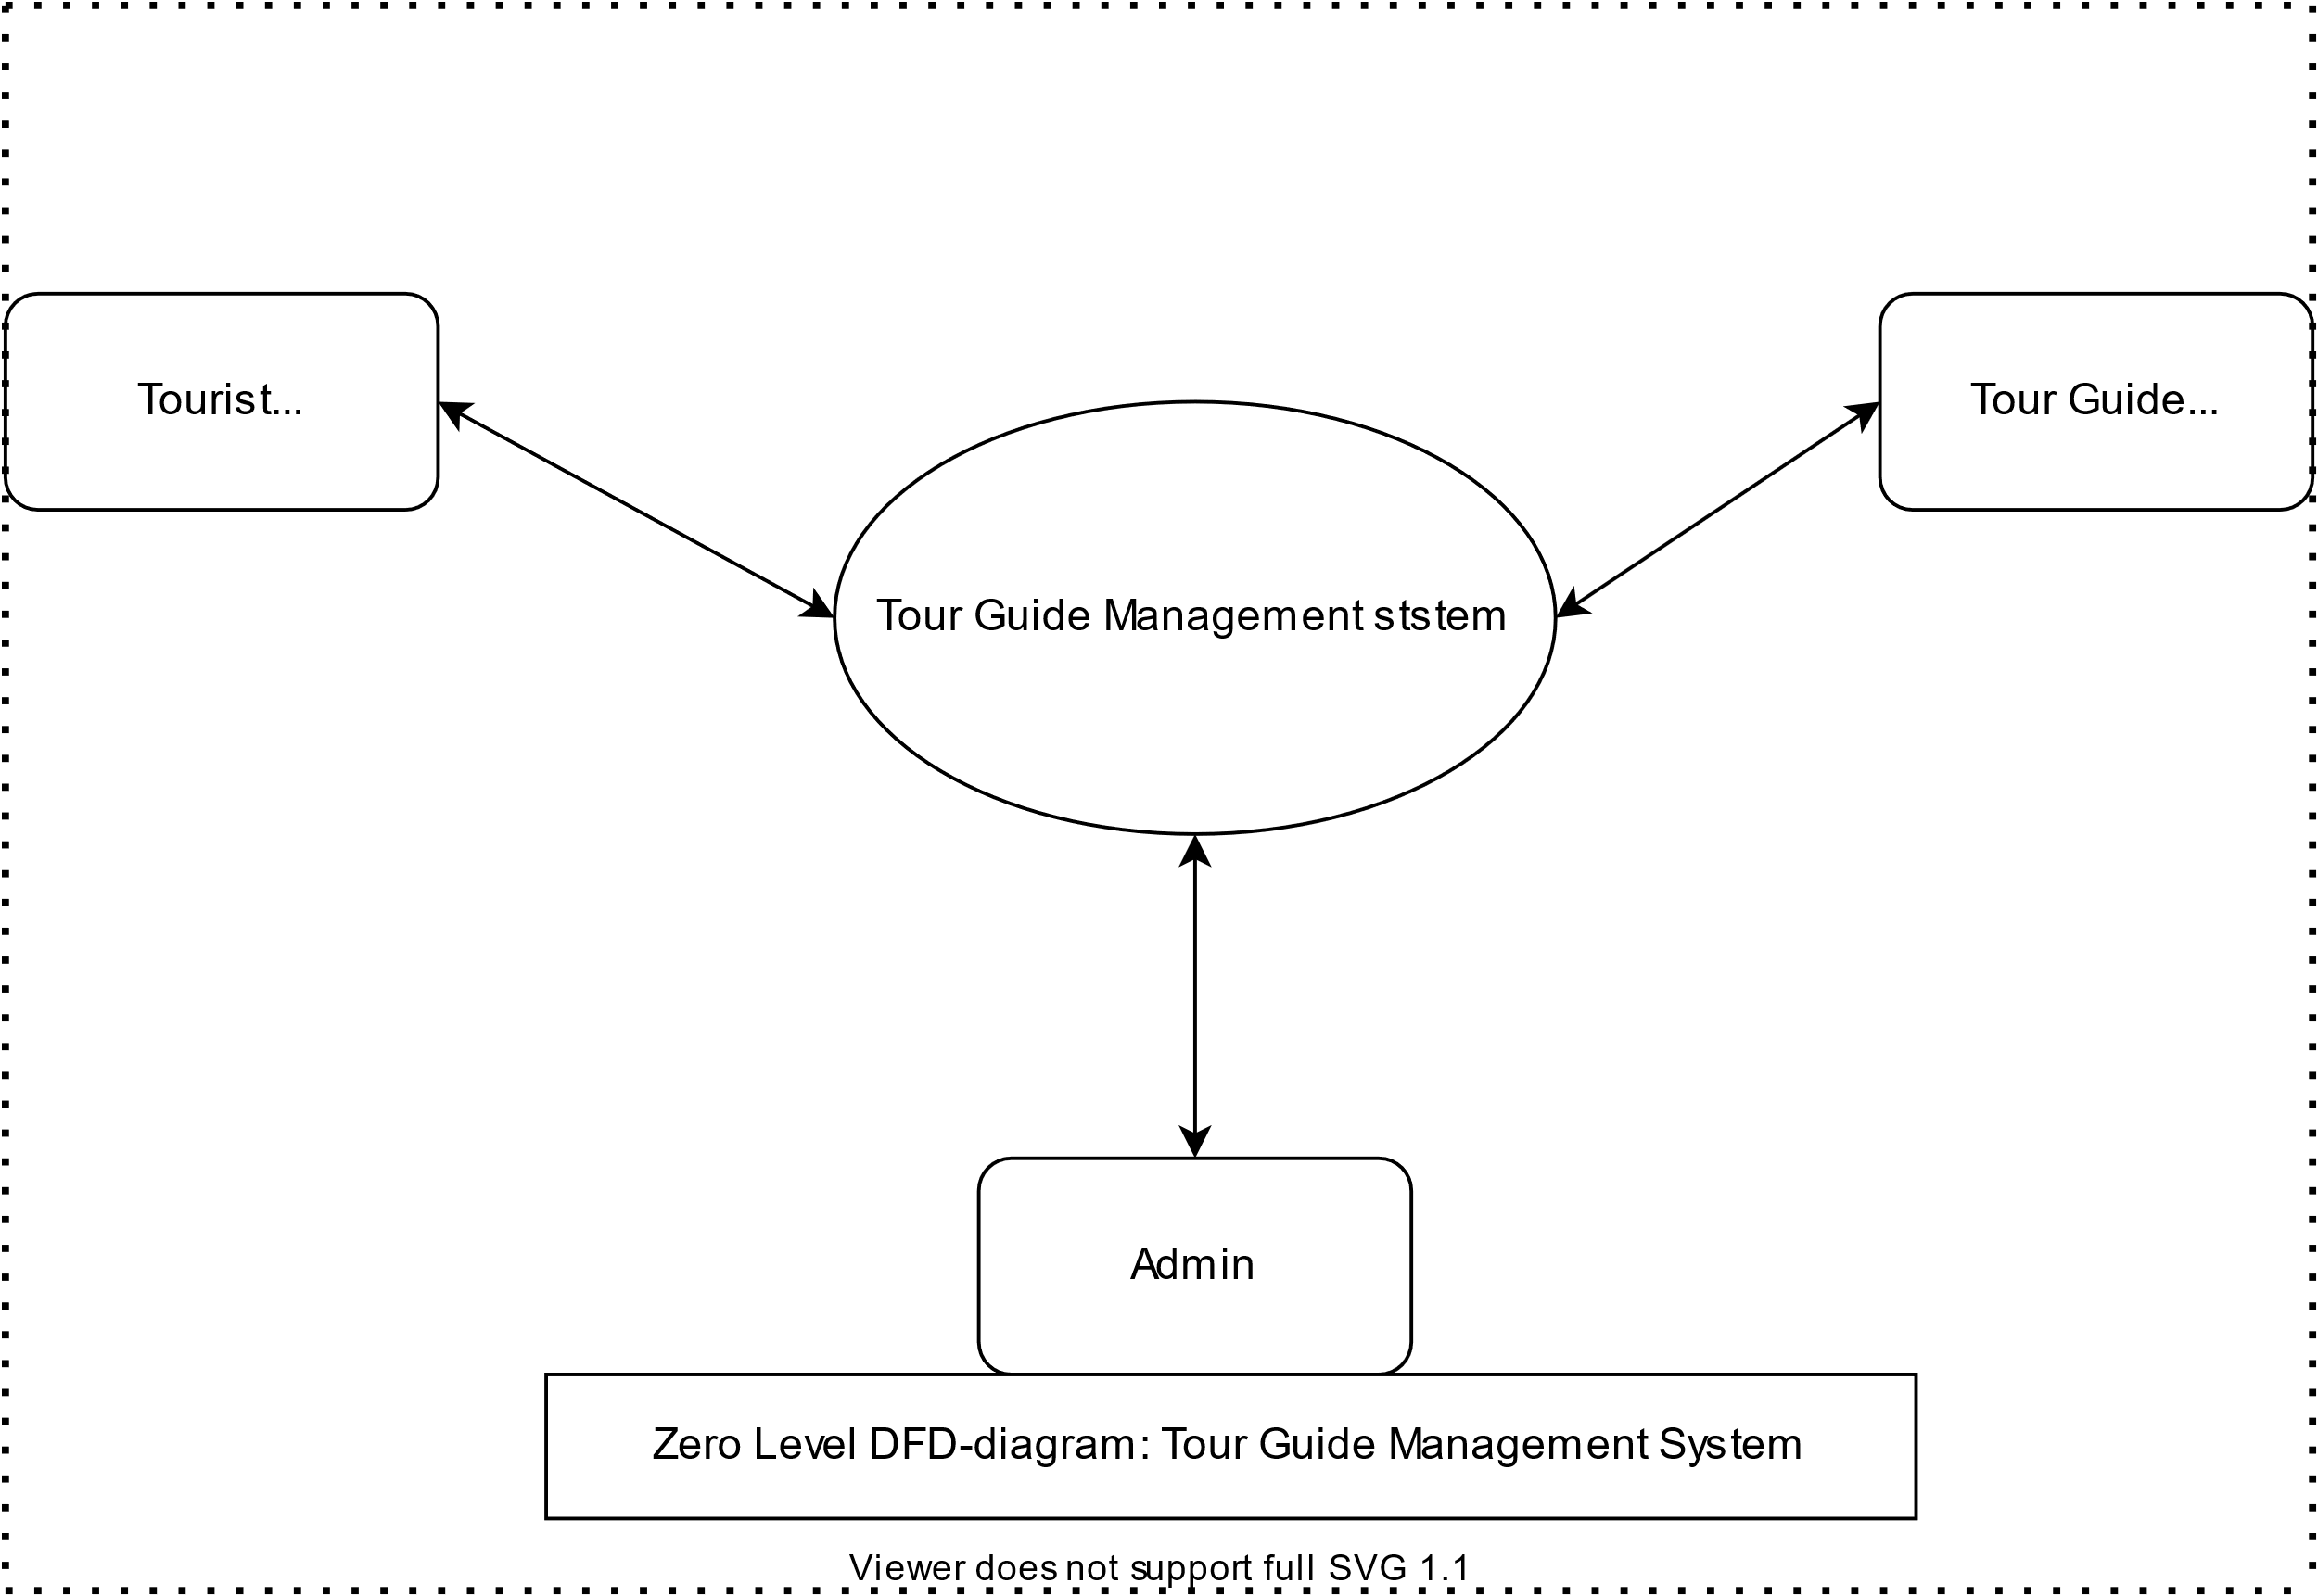
DFD Level 0

Slide 5
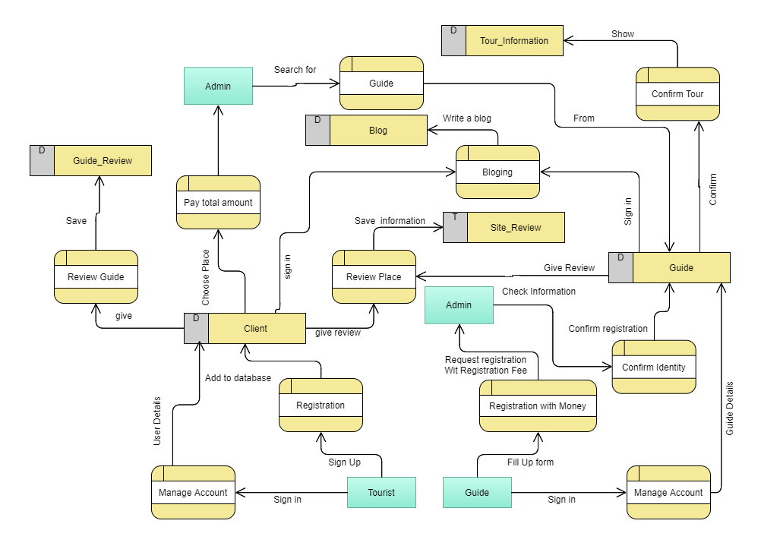
DFD Level 1

Slide 6
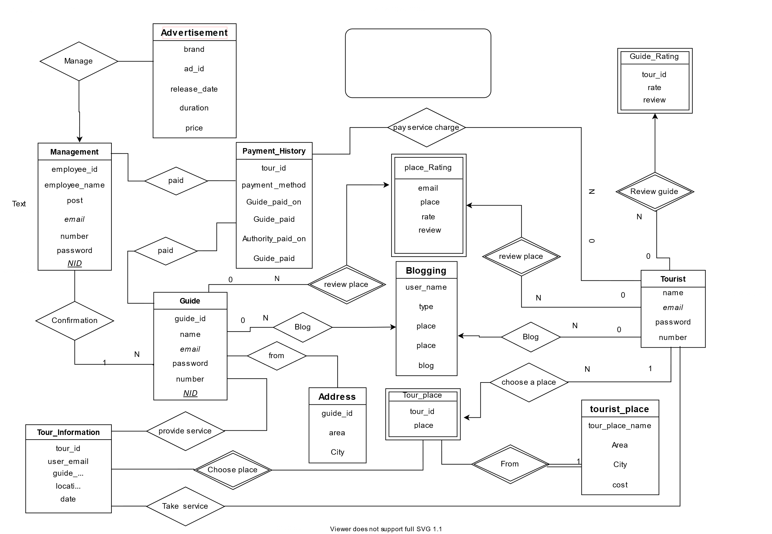
guideMe.com
ER Diagram

Slide 7

Thank you

